Slide 1
CS 4530: Fundamentals of Software Engineering Module 2, Lesson 2 Requirements and Risk
Rob Simmons
Khoury College of Computer Sciences

Slide 2

Review: User Stories
As a College Administrator, I want to keep track of students, the courses they have taken, and the grades they received in those courses, so that I can advise them on their studies.
As a <role> I want <capability>
so that I can <get some benefit>

Slide 3
Satisfaction Conditions
We will build a secure web application backed by a persistent database that allows an authenticated administrator to:
Add a new student to the database
Add a new student with the same name as an existing student.
Retrieve the transcript for a student
Delete a student from the database
Add a new grade for an existing student
Find out the grade that a student got in a course that they took

Slide 4
Writing User Stories: INVEST
Independent
Negotiable
Valuable (has value to client)
Estimable (able to estimate development effort)
Small
Testable
As a <role> I want <capability>
so that I can <get some benefit>
Notes:
INVEST is a popular mnemonic for describing what makes a good user story
Independent – Stories should not be coupled between each other, except where obviously necessary. Want to make it so that a user can examine a story on its own
Negotiable – Best stories are result of a negotiation between a client and a developer – how do we come to some mutual agreement about what we are going to build, and why? Goal is to develop what the customer needs
Valuable – Each story should have some benefit that the client can recognize. Value might include value to your business, not just value to the user.
Estimable (that is, estimatable) – As we will see in a bit, being able to estimate how long it will take to implement a user story is key to determining a reasonable scope for your project
Small – In the real world, a rule of thumb is to average 3-4 days of work per story for a full-time developer. For our projects, it might be something a single student might be able to accomplish in a week, along with their other obligations as a student.
Testable – There must be some way to judge completion: for the person implementing the software, and for the end-user.
https://agileforall.com/new-to-agile-invest-in-good-user-stories/
… Let’s see an example and work through some of the tricky bits

Slide 5
Learning Goals for this Lesson
At the end of this lesson, you should be able to
Explain the overall purposes of requirements analysis
Recall the three major dimensions of risk in requirements analysis
Explain the connection between requirements analysis and user stories
Identify functional and non-functional requirements, and give examples of each

Slide 6






Where does requirements analysis fit in?
PEOPLE
PROCESSES
PROGRAMS
PLANNING
Design problem: what user stories meet the needs of *waves hands at everyone, everywhere*
Design problem: what conditions of satisfaction meet the needs of a given user story?
ORGANIZING
Design problem: what programs meet the needs of a condition of satisfaction?
implementing

Slide 7
Where does requirements analysis fit in?
PEOPLE
PROCESSES
PROGRAMS
PLANNING
Requirements Analysis
User Stories
Testing Conditions of Satisfaction
ORGANIZING
implementing

Slide 8
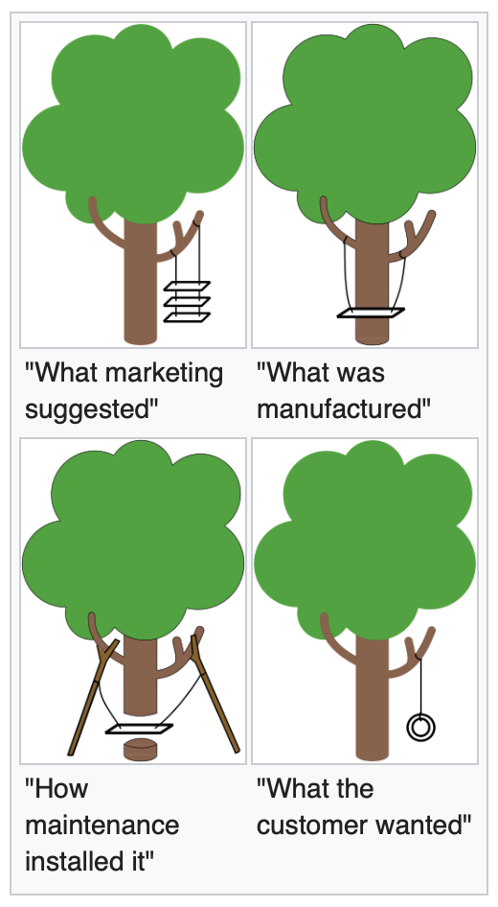
Why care about requirements analysis?
Mostly? Long, painful experience
https://en.wikipedia.org/wiki/Tree_swing_cartoon

Slide 9
Why care about requirements analysis?
Essential for managing risk
Problems of understanding
Do users know what they want?
Do users know what we don’t know?
Do we know who are users even are?
Problems of scope
What are we building?
What non-functional quality attributes are included?
Problems of volatility
Changing requirements over time

Slide 10
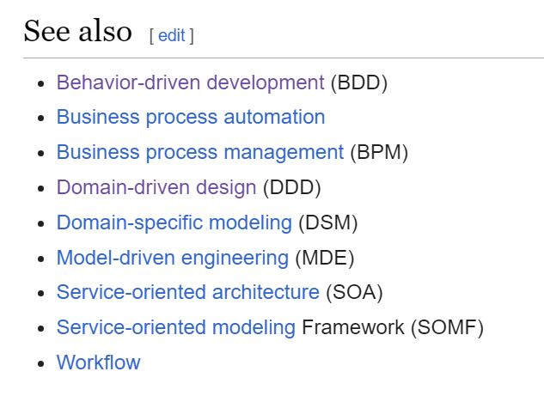
How do we capture the requirements?
There are many methodologies for this.
Often described as x-Driven Design (for some x)
They differ in scope & details, but they have many features in common.
Notes:
In this lesson, we'll primarily be concerned with problems of understanding. How do we get from a customer's vague notions of what they might want to something concrete enough to guide us to build it.
<read slide>

Slide 11
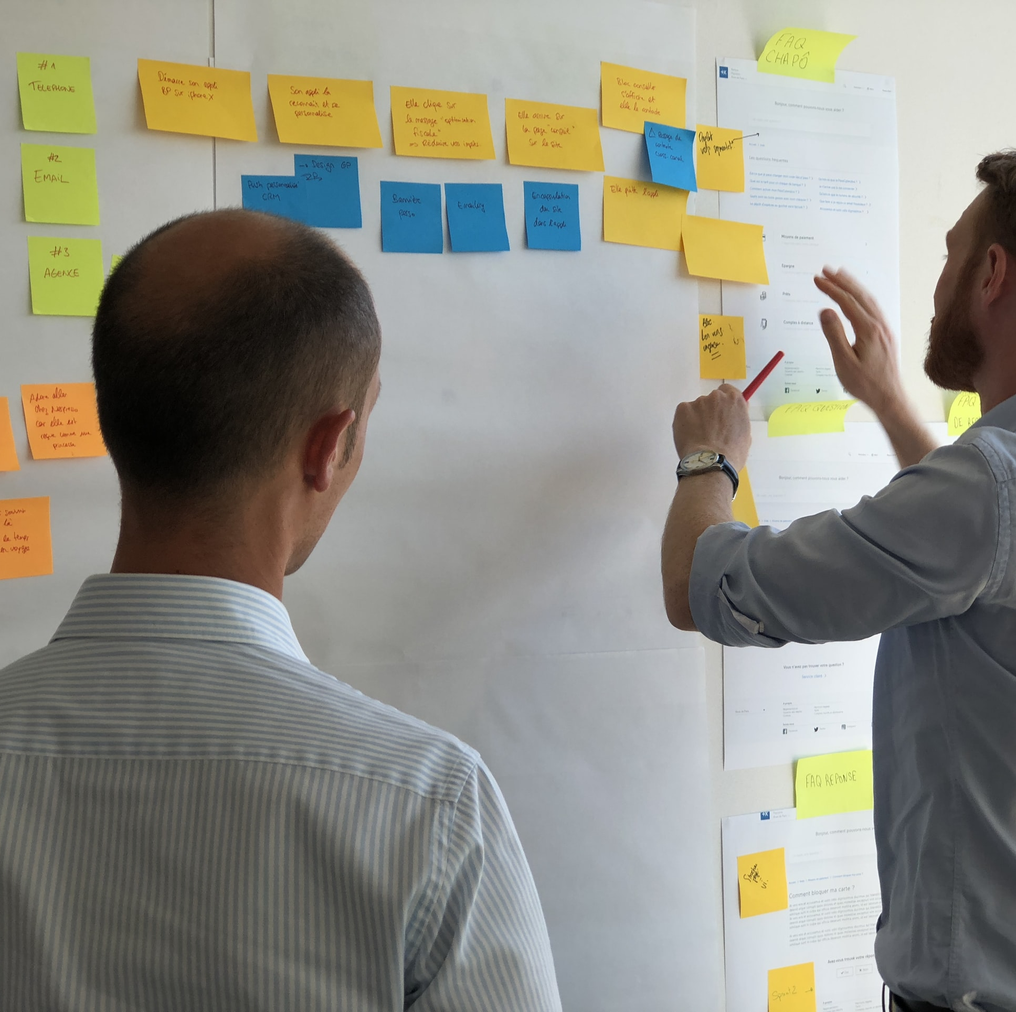
Common Elements
Meet with stakeholders
Develop a common language
Collect desired system behaviors
Document the desired behaviors
Iterate, refine
User stories are the least common denominator of most approaches
Notes:
Here are some things that these different methods have in common. <read slide>

Slide 12
User stories in requirements analysis
User stories (and conditions of satisfaction) define the minimum viable product
Requirements analysis determines the essential user stories
MVP has all the essential components of all essential user stories.
Defining an MVP is important for your course project
User stories have equal footing — digging into requirements analysis for prioritization is outside of class scope
Half your code-based grade on the final project is based on the essential conditions of satisfaction
make your MVP too hard to complete (but don't make it too easy, either)

Slide 13
NOT user stories in requirements analysis
User stories roughly describe the functional requirements
The non-functional requirements are other properties that are also important to users and to other stakeholders?
How quickly can a transcript be retrieval? (Performance)
How many student transcripts can our system store? (Scalability)
How long did I spend on the phone with support to set up the software? (Usability)
After my system is setup, is the access controlled at all? (Security)
Are these any times when I can’t use this system? (Availability)
How expensive will it be to adapt the system to new requirements? (Maintainability)

Slide 14
Example:
“The system should be able to service at least 200 simultaneous clients with less than 300ms latency, while costing less than $500/month on AWS.”

Slide 15
Other non-functional requirements
Accessibility*
Availability
Capacity
Efficiency
Performance
Privacy
Response Time
Security
Supportability
Usability
*We had a good conversation about this in class! Is it a “role” to be colorblind, or to be unable to use a pointing device? There are kind of two ways to answer:
no, “colorblind user” is not a good role for the same reason “user” is not good; colorblind accessibility or screen-reader-friendliness is properly seen as a non-functional requirement
yes, this is a role, and we need to think about roles at the intersection roles, like of ”colorblind x college administrator”
I (Rob the instructor) am taking a relatively strict and prescriptivist stance on user stories in this class, and in class I said I was drawn to the first answer. Non-functional requirements can still be very important!
However, I want to be clear that group projects can have roles in their user stories that involve , and I encourage you to do this if you have interest.

Slide 16
Still more non-functional requirements
Qualities that reflect the evolution of the system
Testability
Maintainability
Extensibility
Scalability
Over-focusing on user stories and design requirements can be counterproductive in the long term! (Under-focusing on user stories and design can be terrible for a hackathon)
Specifying the intended long-term maintainability of a system is part of requirements analysis — but beware changing requirements around longevity

Slide 17
Review
It’s the end of this lesson, so you should be able to:
Explain the overall purposes of requirements analysis
Recall the three major dimensions of risk in requirements analysis
Explain the connection between requirements analysis and user stories
Identify functional and non-functional requirements, and give examples of each

